Slide 1
Introduction to Digital Logic and Design and Number System

Slide 2
DIGITAL.
The term "digital" refers to anything that involves the use of computer technology, electronic devices, or data encoded in binary code (1s and 0s).
Digital technology has changed the way we live, work, and communicate by enabling faster, more efficient processing and storage of information.
In the context of communication and media, "digital" refers to digital media, such as photos, videos, and text that can be shared and accessed online.
Digital media can be easily edited and shared across a variety of platforms, including social media, websites, and mobile apps.

Slide 3
In the context of communication and media, "digital" refers to digital media, such as photos, videos, and text that can be shared and accessed online. Digital media can be easily edited and shared across a variety of platforms, including social media, websites, and mobile apps.
Digital describes electronic technology that generates, stores, and processes data in terms of two states: positive and non-positive. Positive is expressed or represented by the number 1 and non-positive by the number 0. Thus, data transmitted or stored with digital technology is expressed as a string of 0's and 1

Slide 4
Logic.
Logic refers to algorithms and operational sequences.
The sequence of operations performed by hardware or software.
It is the computer's "intelligence."
Hardware logic is contained in the electronic circuits and follows the rules of Boolean logic.
Software logic (program logic) is contained in the placement of instructions written by the programmer.

Slide 5
In computer science, logical thinking and problem-solving skills are essential for designing algorithms, developing software, and troubleshooting issues in computer systems. By applying logical reasoning and principles, computer scientists can identify problems, formulate hypotheses, and test solutions to complex problems.

Slide 6
Design.
In computer science, logical thinking and problem-solving skills are essential for designing algorithms, developing software, and troubleshooting issues in computer systems. By applying logical reasoning and principles, computer scientists can identify problems, formulate hypotheses, and test solutions to complex problems.
Software design typically follows a systematic approach that involves several stages, including requirements analysis, architectural design, detailed design, implementation, and testing. During each stage, designers use various techniques and tools to create and refine the design, such as flowcharts, diagrams, and software design patterns.

Slide 7
Digital logic design.
Digital logic design is the process of creating digital circuits or systems that operate on binary signals (0s and 1s). It involves using logic gates and other digital components to perform specific operations, such as arithmetic, data storage, and control.
Digital logic design is used in a wide range of applications, from simple digital systems, such as calculators and traffic lights, to complex systems, such as computer processors and communication networks. Good digital logic design practices are essential for creating circuits that are reliable, efficient, and cost-effective.

Slide 8
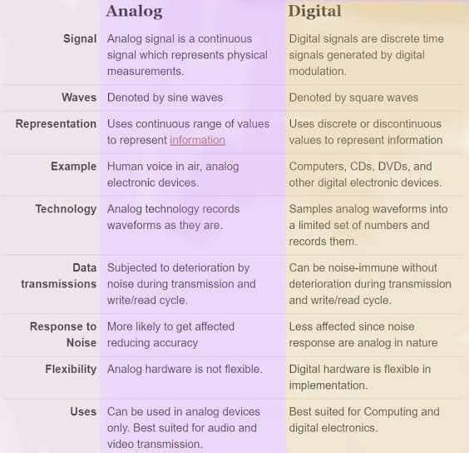
Difference between analog systems and digital systems.

Slide 9
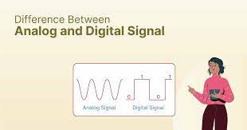

Slide 10
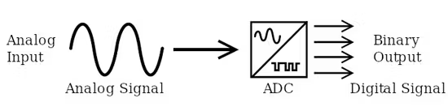
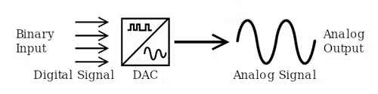
Conversion of ADC and DAC
As its name implies, an analog-to-digital converter (ADC) takes an analog wave as an input and converts this wave to a digitally represented output form (Fig. 1).
A digital-to-analog converter (DAC) essentially does the reverse, converting a digital representation into an analog form (Fig. 2).

Slide 11
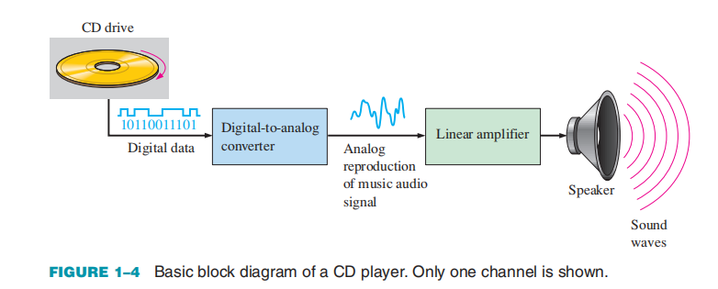
Example: A System Using Digital and Analog Methods
The compact disk (CD) player is an example of a system in which both digital and analog circuits are used. The simplified block diagram in Figure 1–4 illustrates the basic principle. Music in digital form is stored on the compact disk. A laser diode optical system picks up the digital data from the rotating disk and transfers it to the digital-to-analog converter (DAC). The DAC changes the digital data into an analog signal that is an electrical reproduction of the original music. This signal is amplified and sent to the speaker for you to enjoy. When the music was originally recorded on the CD, a process, essentially the reverse of the one described here, using an analog-to-digital converter (ADC) was used.

Slide 12
Introduction to Digital Signal
Digital signals are not continuous, but signals are discrete in value and time.
These signals are represented by binary numbers and consist of different voltage values.
Binary Digits
Each of the two digits in the binary system, 1 and 0, is called a bit, which is a contraction of the words binary digit.
In digital circuits, two different voltage levels are used to represent the two bits.
Generally,1 is represented by the higher voltage, which we will refer to as a HIGH, and a 0 is represented by the lower voltage level, which we will refer to as a LOW.
HIGH = 1 and LOW = 0

Slide 13
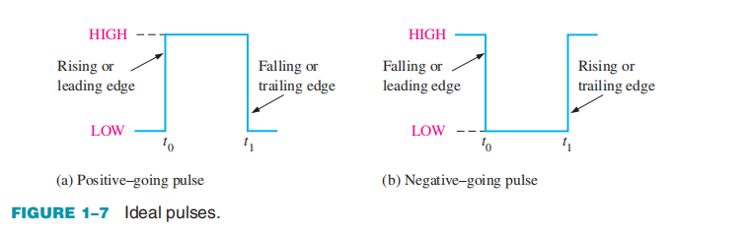
Digital Waveforms
Digital waveforms consist of voltage levels that are changing back and forth between the HIGH and LOW levels or states.
Figure 1–7(a) shows that a single positive-going pulse is generated when the voltage (or current) goes from its normally LOW level to its HIGH level and then back to its LOW level.
The negative-going pulse in Figure 1–7(b) is generated when the voltage goes from its normally HIGH level to its LOW level and back to its HIGH level.
A digital waveform is made up of a series of pulses.
As indicated in Figure 1–7, a pulse has two edges:
A leading edge that occurs first at time t0
A trailing edge that occurs last at time t1.
For a positive-going pulse, the leading edge is a rising edge.
and the trailing edge is a falling edge.

Slide 14
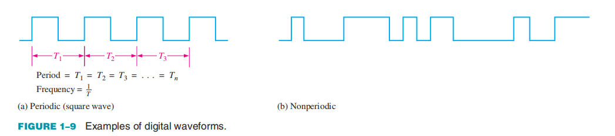
Waveform Characteristics
Most waveforms encountered in digital systems are composed of series of pulses, sometimes called pulse trains, and can be classified as either periodic or nonperiodic.
A periodic pulse waveform is one that repeats itself at a fixed interval, called a period (T). The frequency ( f ) is the rate at which it repeats itself and is measured in hertz (Hz).
A nonperiodic pulse waveform, of course, does not repeat itself at fixed intervals and may be composed of pulses of randomly differing pulse widths and/or randomly differing time intervals between the pulses.

Slide 15
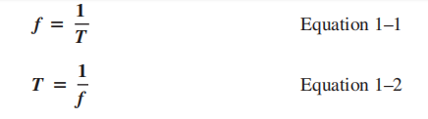

The frequency ( f ) of a pulse (digital) waveform is the reciprocal of the period.
The relationship between frequency and period is expressed as follows:
An important characteristic of a periodic digital waveform is its duty cycle, which is the ratio of the pulse width (tW) to the period (T).
It can be expressed as a percentage.

Slide 16
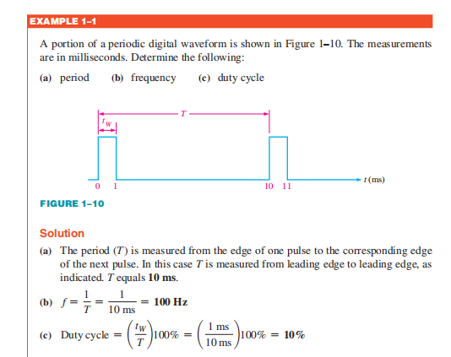

Slide 17
What are Logic gates ?
Logic gate is electronic circuit which can take one or more inputs but output will be one.
Logic gates are made of transistor and diode.
Digital electronic circuits operate with voltages of two logic levels namely Logic Low and Logic High.
The range of voltages corresponding to Logic Low is represented with ‘0’. Similarly, the range of voltages corresponding to Logic High is represented with 1.
Hence, the Logic gates are the building blocks of any digital system.
Notes:
In simple words, we can say that a transistor is a mini device that is used to control or regulate the flow of electronic signals.
A laptop processor has approximately 3 billion transistors.
Diode is an electronic device with two transmitting terminals that allows electric current to flow in one direction while blocking current in the opposite direction. An example of a diode is a light-emitting diode, an LED.

Slide 18
We can classify these Logic gates into the following three categories.
Basic gates
Universal gates
Special gates
The basic gates are AND, OR & NOT gates.
There are two types of universal gates present in digital electronics they are NAND and NOR gates.
Special gates are XOR and XNOR.

Slide 19
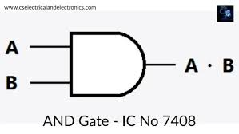
AND Gate
An AND gate is a digital circuit that has two or more inputs and produces an output, which is the logical AND of all those inputs.
Here A, B are the inputs and Y is the output of two input AND gate. If both inputs are ‘1’, then only the output, Y is ‘1’. For remaining combinations of inputs, the output, Y is ‘0’.
A | B | Y = A.B
0 | 0 | 0
0 | 1 | 0
1 | 0 | 0
1 | 1 | 1

Slide 20
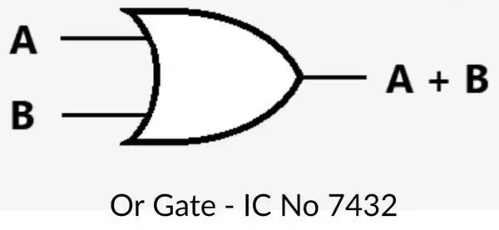
2. OR Gate
An OR gate is a digital circuit that has two or more inputs and produces an output, which is the logical OR of all those inputs. This logical OR is represented with the symbol ‘+’.
Here A, B are the inputs and Y is the output of two input OR gate. If both inputs are ‘0’, then only the output, Y is ‘0’. For remaining combinations of inputs, the output, Y is ‘1’.
A | B | Y = A + B
0 | 0 | 0
0 | 1 | 1
1 | 0 | 1
1 | 1 | 1

Slide 21
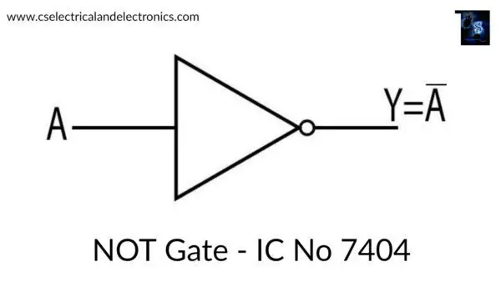
3. NOT Gate
A NOT gate is a digital circuit that has single input and single output. The output of NOT gate is the logical inversion of input. Hence, the NOT gate is also called as inverter.
As the symbol of not operation is ( – ) bar. If the value of A is 1. then Ā = 0 and in the opposite if the value of A is then Ā = 1.
A | Y = A’
0 | 1
1 | 0

Slide 22
Universal gates
A universal gate is a gate that can execute any Boolean function without the requirement to use any other gate type. The NAND and NOR gates are universal gates.
NAND and NOR gates are called universal gates because they can perform all the three basic logic functions OR, AND,NOT.
Boolean function:
A Boolean Function is described by an algebraic expression called Boolean expression which consists of binary variables, the constants 0 and 1, and the logic operation symbols.
Both NAND and NOR gates can be used to implement any other logic gate.
For example, you can construct an AND gate using only NAND gates or a NOT gate using only NOR gates.
By combining these universal gates in various ways, you can create complex logic circuits to perform any logical function.

Slide 23
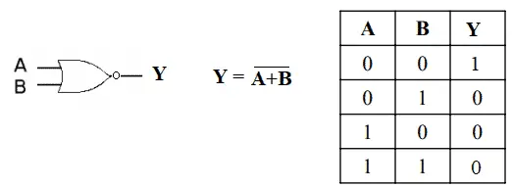
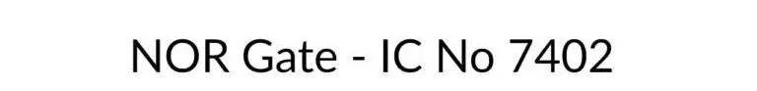
4. NOR Gate
The output of NOR Gate is ‘High’ if both the inputs are ‘Low’. The output is ‘Low’ if both the inputs are ‘High’ or either of the input is ‘High’.
NOR Gate is compliment of OR Gate.

Slide 24
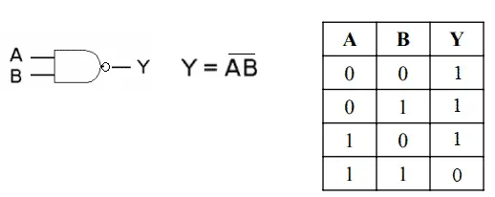
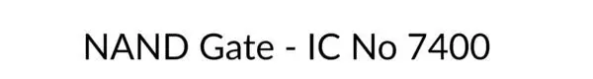
5. NAND Gate
The output of NAND Gate is ‘High’ if both the inputs are ‘Low’ and if either of the input is ‘Low’. The output is ‘Low’ if both the inputs are ‘High’.
NAND Gate is compliment of AND Gate.

Slide 25
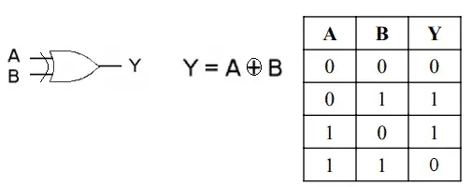
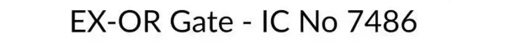
6. X-OR Gate
The output of XOR Gate is ‘High’ if either of the input is ‘High’. The output is ‘Low’ if both the inputs are ‘High’ or if both the inputs are ‘Low’.
Also called Inequality detector.

Slide 26
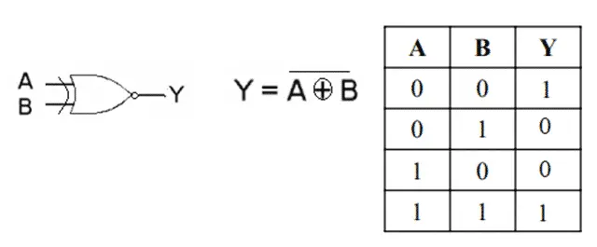
7. X-NOR Gate
The output of XNOR Gate is ‘High’ if both the inputs are ‘High’ or if both the inputs are ‘Low’. The output is ‘Low’ if either of the input is ‘Low’.
Also called Equality detector.
IC number of XNOR Gate is 4077.

Slide 27
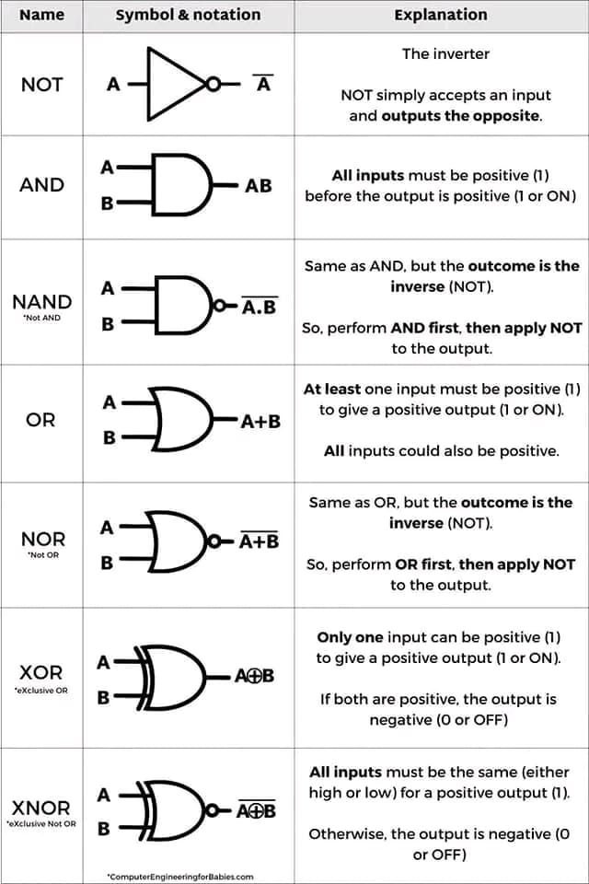

Slide 28
Logic Gates Applications
Logic gates applications are mainly based upon their mode of operations or their truth table and are used in the microcontroller, microprocessor, embedded system application, electrical and electronic circuits.
Basic logic gates are often seen in circuits such as safety thermostats, automatic watering systems, push-button locks, light-activated burglar alarms and many other electronic devices.
Logical gates are used to carry out multiple binary operations.
One of the primary advantages is that basic logic gates can be applied in a blend of different combinations if the operations are advanced.
In digital integrated circuits (ICs) we will see an array of the logic gate area unit.

